Slide 1
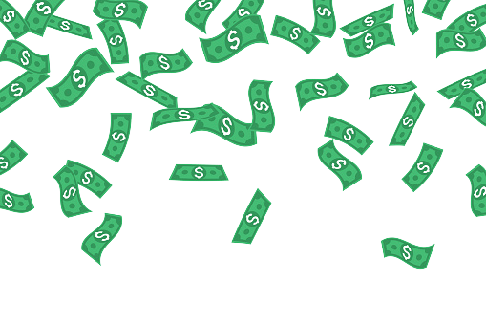


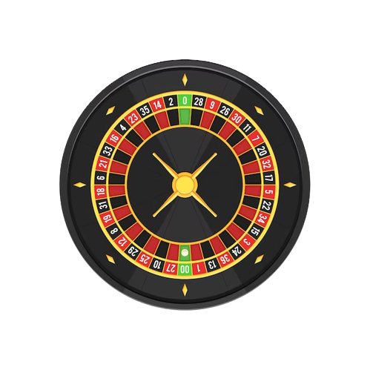
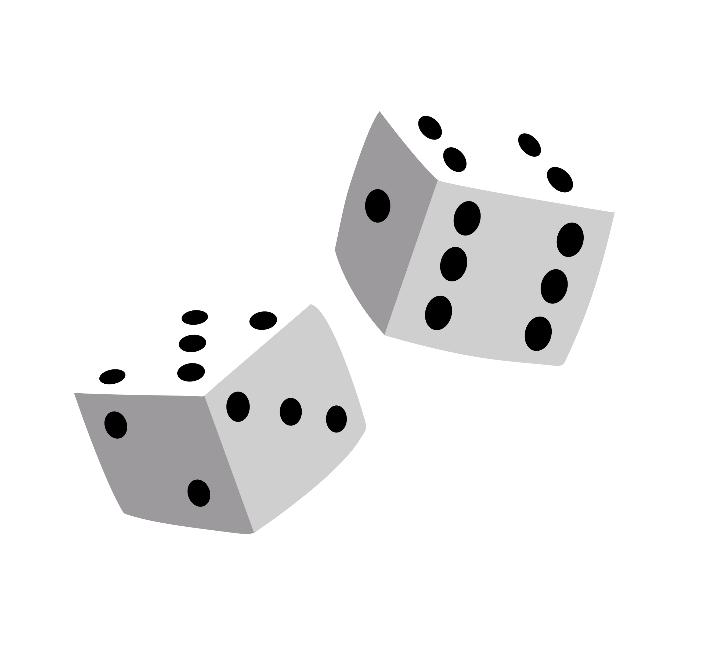

Java Projekt - Casino
Filip Bureš 2.Ai

Slide 2

Informace
O čem projekt je
Proč bylo vybrané dané téma
Jak dlouho probíhala práce

Slide 3
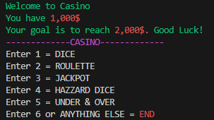
Casino
//-------------------------START-------------------------------
public static void start() {
if(won == true){
dollars = 1000;
won = false;
}
Scanner sc = new Scanner (System.in);
System.out.println(purple + "-------------CASINO-------------"+ reset);
System.out.println("Enter 1 = DICE");
System.out.println("Enter 2 = ROULETTE");
System.out.println("Enter 3 = JACKPOT");
System.out.println("Enter 4 = HAZZARD DICE");
System.out.println("Enter 5 = UNDER & OVER");
System.out.println("Enter 6 or ANYTHING ELSE = " + red + "END" + reset);
int whichGame = sc.nextInt();
switch (whichGame) {
case 1 -> dice();
case 2 -> roulette();
case 3 -> jackpot();
case 4 -> hazzardDice();
case 5 -> underAndOver();
default -> end();
}
}

Slide 4
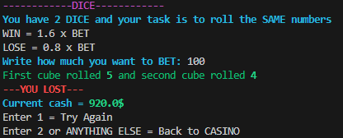
Dices
int cube1 = (int)Math.floor(Math.random() * 6) + 1;
int cube2 = (int)Math.floor(Math.random() * 6) + 1;
System.out.println(green + "First cube rolled " + bold_green + cube1 + unbold_reset + green + " and second cube rolled " + bold_green + cube2 + unbold_reset + reset);
if(cube1 == cube2){
System.out.println(bold_green + "---YOU WON!---" + unbold_reset);
dollars = dollars + 1.6 * bet ;
}else{
System.out.println(bold_red + "---YOU LOST---" + unbold_reset);
dollars = dollars - 0.8 * bet ;
}
if(dollars >= 2000){
win();
}
System.out.println(bold_cyan + "Current cash = " + unbold_reset + bold_green + dollars + "$" + unbold_reset);
System.out.println("Enter 1 = Try Again");
System.out.println("Enter 2 or ANYTHING ELSE = Back to CASINO");
int again = sc.nextInt();
switch (again) {
case 1 -> dice();
case 2 -> start();
default -> start();
}

Slide 5
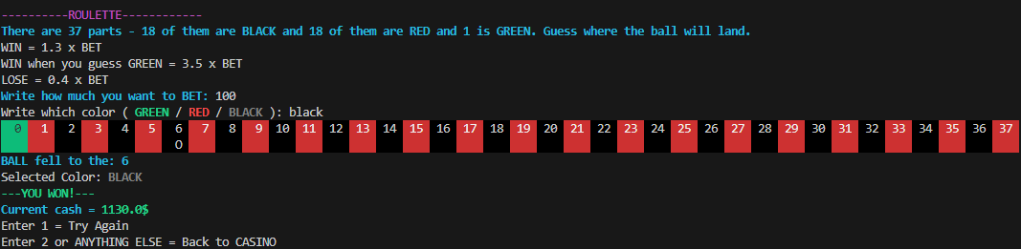

Roulette
int ball = (int)Math.floor(Math.random() * 38);
for (int i = 0; i <= 37; i++) {
if(i == 0){
System.out.print(green_background + " " + i + " " + reset);
}else if(i % 2 == 0){
if(i <= 9){
System.out.print(black_background + " " + i + " " + reset);
}else{
System.out.print(black_background + " " + i + " " + reset);
}
}else{
if(i <= 9){
System.out.print(red_background + " " + i + " " + reset);
}else{
System.out.print(red_background + " " + i + " " + reset);
}
}
}

Slide 6
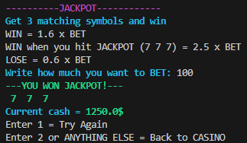
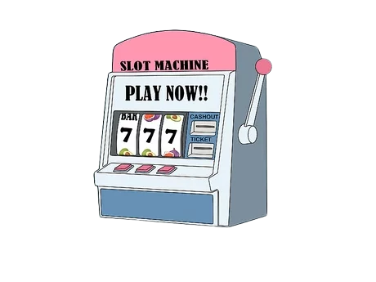
Jackpot
String firstValue = "";
String secondValue = "";
String thirdValue = "";
int jackpot1 = (int)Math.floor(Math.random() * 3) + 1;
int jackpot2 = (int)Math.floor(Math.random() * 3) + 1;
int jackpot3 = (int)Math.floor(Math.random() * 3) + 1;
switch(jackpot1){
case 1 -> firstValue = apple;
case 2 -> firstValue = cross;
case 3 -> firstValue = seven;
}
switch(jackpot2){
case 1 -> secondValue = apple;
case 2 -> secondValue = cross;
case 3 -> secondValue = seven;
}
switch(jackpot3){
case 1 -> thirdValue = apple;
case 2 -> thirdValue = cross;
case 3 -> thirdValue = seven;
}

Slide 7
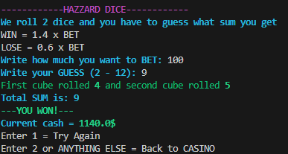


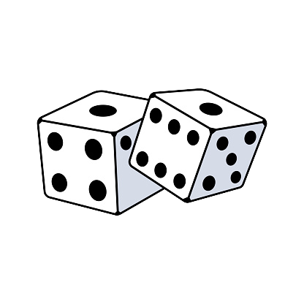
Hazzard Dice
while(dices){
System.out.print(bold_cyan + "Write your GUESS (2 - 12): " + reset);
tip = sc.nextInt();
dices = false;
if(tip < 2 || tip > 12){
dices = true;
System.out.println("You didn't guess a number between 2 - 12, try again");
}
}
int cube1 = (int)Math.floor(Math.random() * 6) + 1;
int cube2 = (int)Math.floor(Math.random() * 6) + 1;
System.out.println(green + "First cube rolled " + bold_green + cube1 + unbold_reset
+ green + " and second cube rolled " + bold_green + cube2 + unbold_reset + reset);
int total = cube1 + cube2;
System.out.println(bold_cyan + "Total SUM is: " + total + reset);
if(total == tip){
System.out.println(bold_green + "---YOU WON!---" + unbold_reset);
dollars = dollars + 1.4 * bet ;
}else{
System.out.println(bold_red + "---YOU LOST---" + unbold_reset);
dollars = dollars - 0.6 * bet ;
}

Slide 8

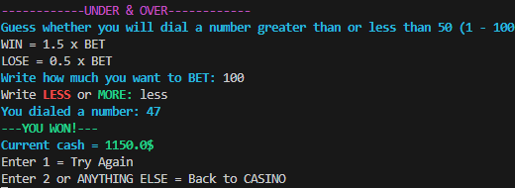
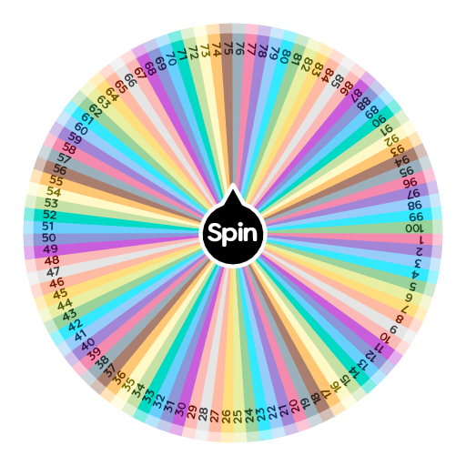
Under & Over
boolean fifty = true;
int num = 0;
while(fifty){
num = (int)Math.floor(Math.random() * 100) + 1;
fifty = false;
if(num == 50){
fifty = true;
}
}
System.out.println(bold_cyan + "You dialed a number: " + num + reset);
if(num > 50 && guess.toUpperCase().equals("MORE") || num < 50 && guess.toUpperCase().equals("LESS")){
System.out.println(bold_green + "---YOU WON!---" + unbold_reset);
dollars = dollars + 1.5 * bet ;
}else{
System.out.println(bold_red + "---YOU LOST---" + unbold_reset);
dollars = dollars - 0.5 * bet ;
}

Slide 9
Zdroje
Obrázky:
https://www.istockphoto.com/cs/vektor/kreslen%C3%A1-dv%C4%9B-kostky-vektorov%C3%A1-ilustrace-gm1269780394-372980793,
https://www.wikihow.cz/Jak-hr%C3%A1t-na-v%C3%BDhern%C3%ADch-automatech
https://spinthewheel.app/100
https://www.flaticon.com/free-icon/roulette-wheel_8274015
https://www.flaticon.com/free-icon/roulette-wheel_3425938

